Slide 1
ONLINE COLLEGE MAGAZINE
 | BY
M VINAY KUMAR | (16RJ1A05C8)
M ANJANEYULU RAJU | (16RJ1A05F0)
M LOKANAND | (16RJ1A05F3)
GUIDE
K.KISHORE

Slide 2
ABSTRACT
The objective is to design and develop a system for the processing of creating and managing an online college magazine where college students and faculties can post and read various articles.

Slide 3
GOAL / OBJECTIVE
Online college magazine is web project where students/faculties can post and read various articles .
Every students/faculties can view and post their ideas because this is not a printed magazine .

Slide 4
EXISTING SYSTEM
In this system all students/faculties make it to the printed magazine and no user friendly interactive place where students/faculties can share their ideas.
DISADVATANGES
DATA CAN BE LOST
REQUIRES HUMAN POWER
WASTAGE OF PAPER

Slide 5
PROPOSED SYSTEM
The proposed system maintains all information in a centralized database.
Here students and faculties share their ideas through Articles easily.
ADVANTAGES
Articles can be searched by members ,moderators , admin .
The system allows to conduct all operations effectively and efficiently.
Large number of data can be stored without any missing of information .

Slide 6
SOFTWARE REQUIREMENTS
Technology : PYTHON 3.6.2
Framework : Django
Web Technologies : Html, JavaScript, CSS
IDE : Pycharm
Web Server : Django Server
Database : SQLite3

Slide 7
HARDWARE REQUIREMENTS
Processor : Pentium
Speed : 1.1 GHz
RAM : 1GB
Hard Disk : 20 GB

Slide 8
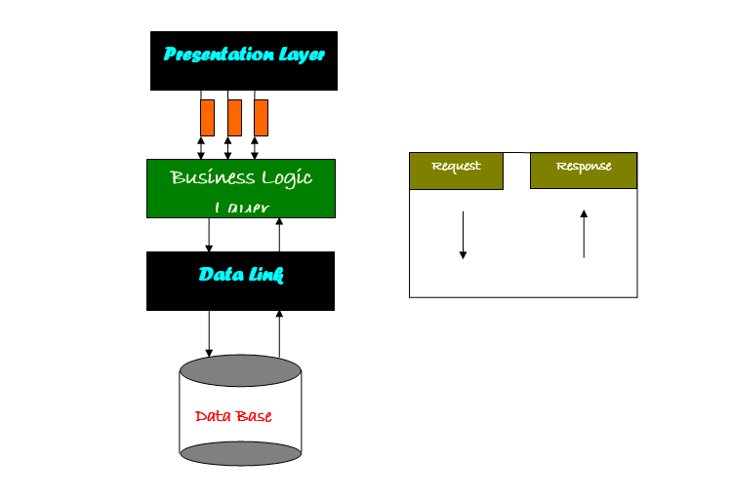
SYSTEM ARCHITECTURE
Presentation layer
Business logic
layer
request
response
Data link layer
Data base

Slide 9
Modules
Guest/Anonymous
Registered Members(Students/faculty)
Moderators
Administrators

Slide 10
Guest/Anonymous
Guests can read articles but can’t post articles unless they sign in as registered users.

Slide 11
REGISTERED MEMBERS
Registered members ,Moderators and Administrators are allowed to post articles.
Registered users ,Moderators , and Admins will have their own profile .

Slide 12
MODERATORS
Moderators will have associated categories, according to which to be validate articles .
They can also post articles .

Slide 13
ADMINISTRATOR
Admin can add / delete moderators and remove members .
Admin has all the privileges a moderator has.

Slide 14
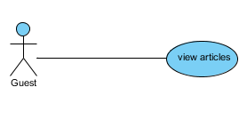
GUEST USECASE DIAGRAM

Slide 15
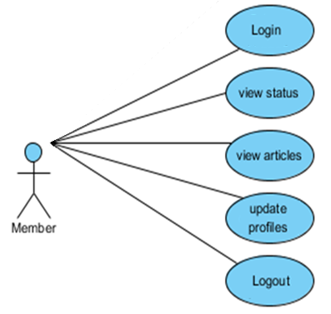
MEMBER USECASE DIAGRAM

Slide 16
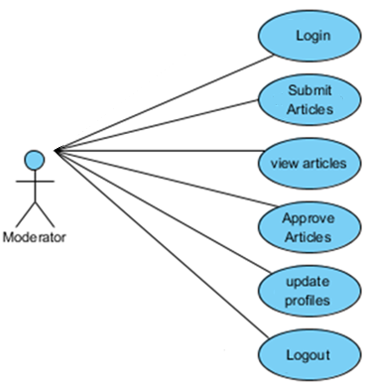
MODERATOR USECASE DIAGRAM

Slide 17
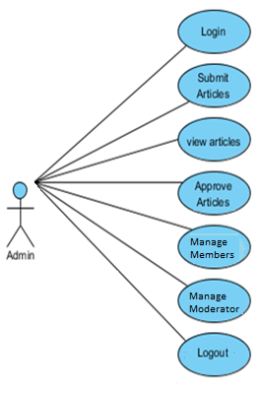
ADMIN USECASE DIAGRAM

Slide 18
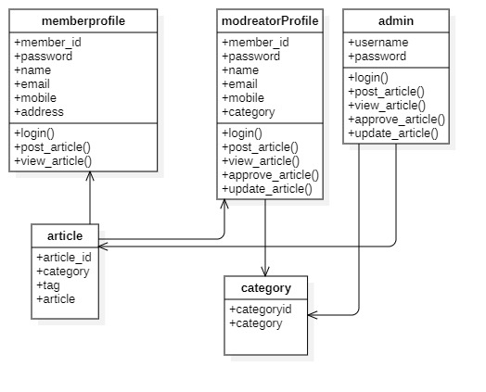
CLASS
DIAGRAM

Slide 19
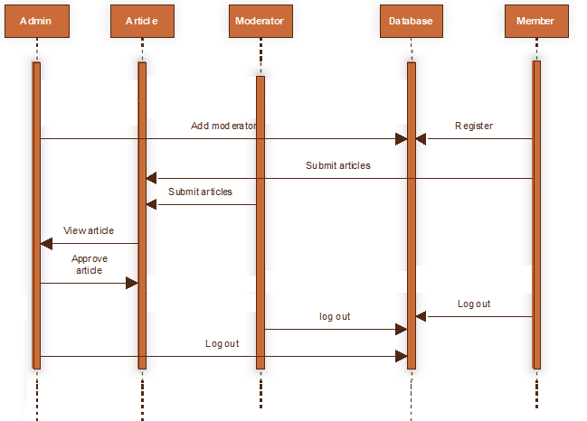
SEQUENCE
DIAGRAM

Slide 20
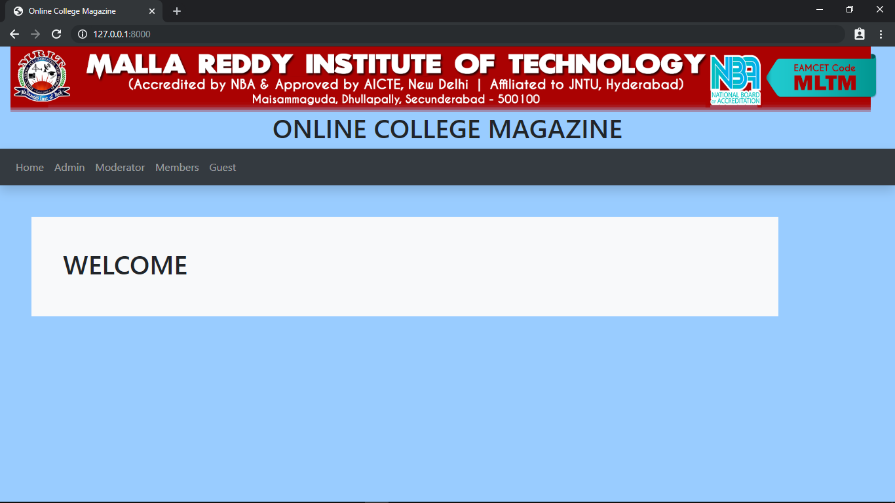
WEBSITE HOME PAGE

Slide 21
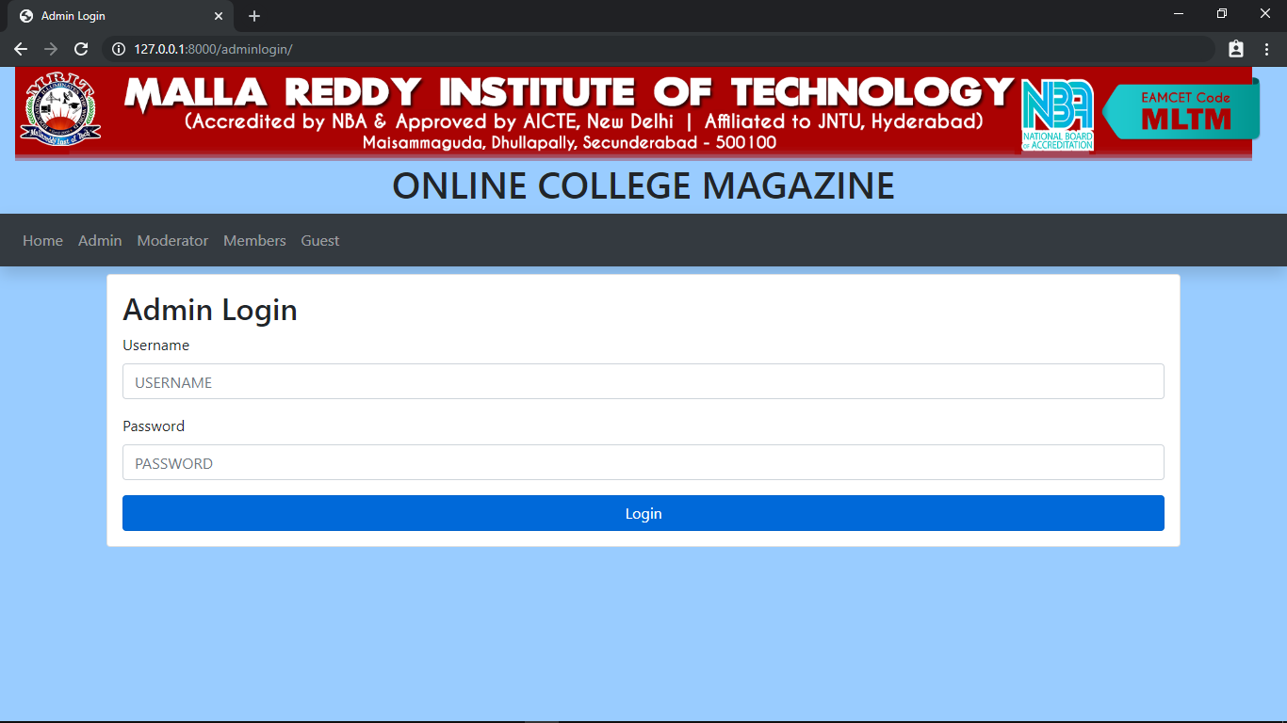
ADMIN LOGIN PAGE

Slide 22
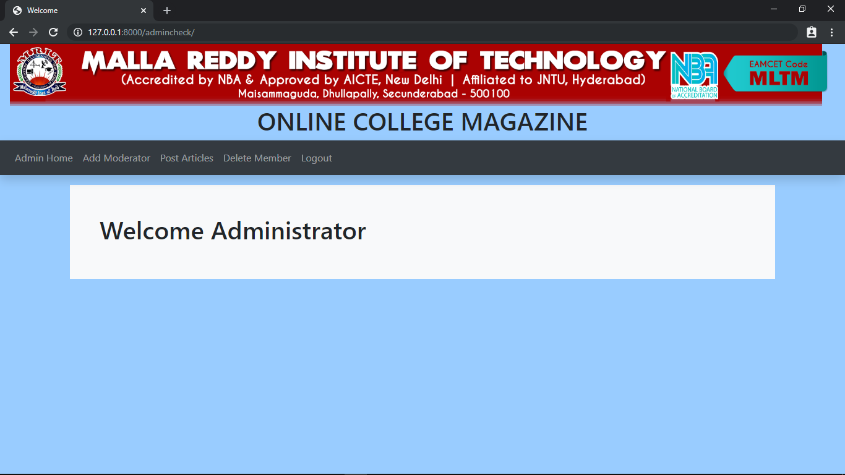
ADMIN HOME PAGE

Slide 23
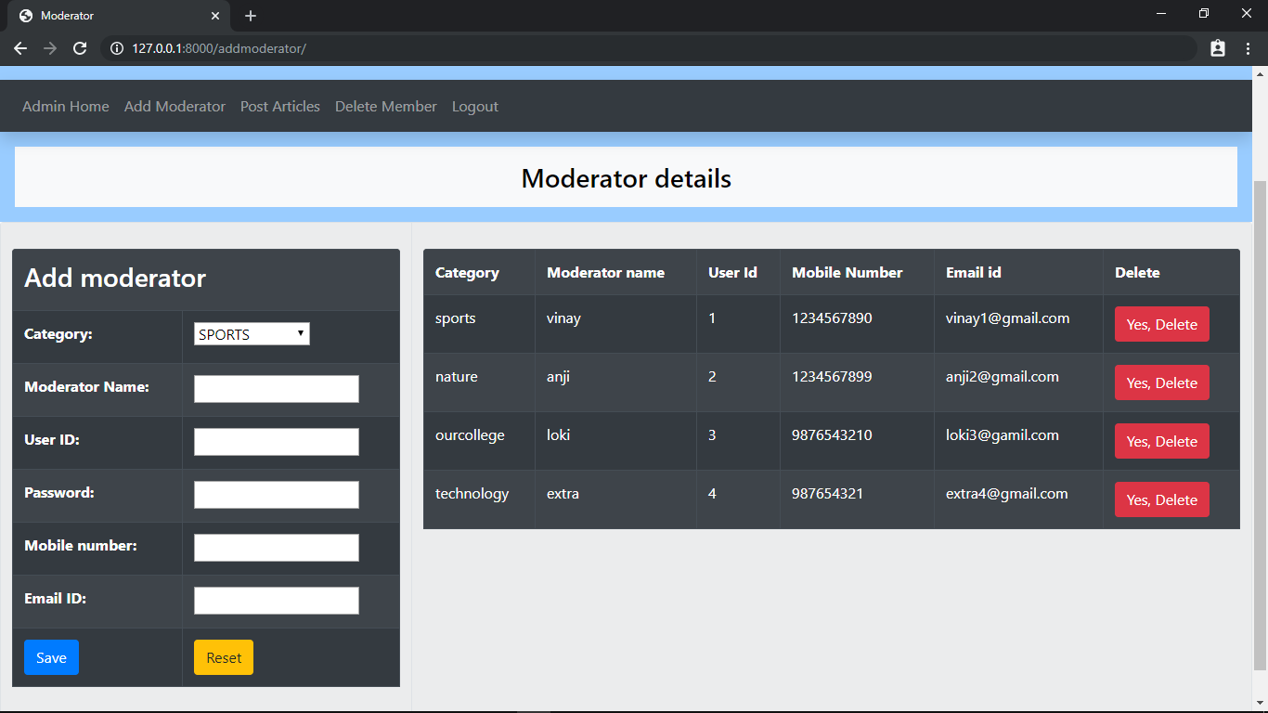
ADMIN PAGE(MODERATOR DETAILS)

Slide 24

MODERATOR LOGIN PAGE

Slide 25
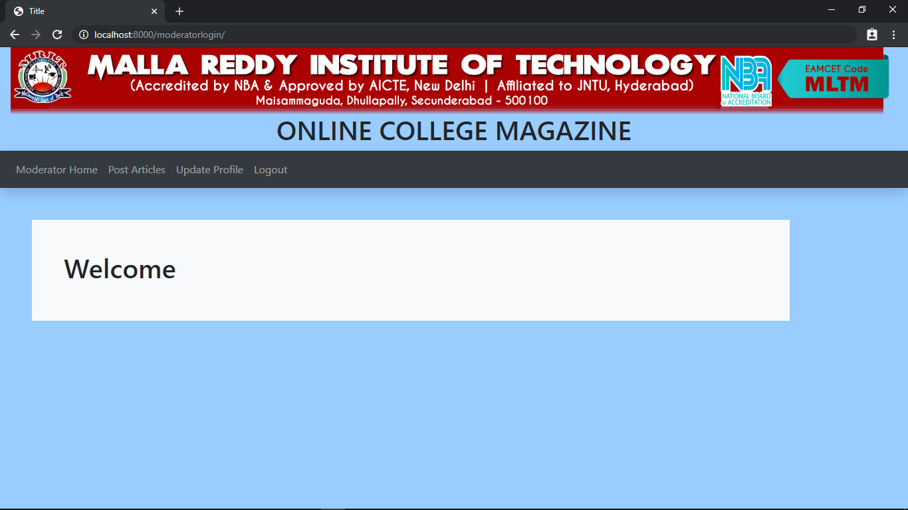
MODERATOR HOME PAGE

Slide 26
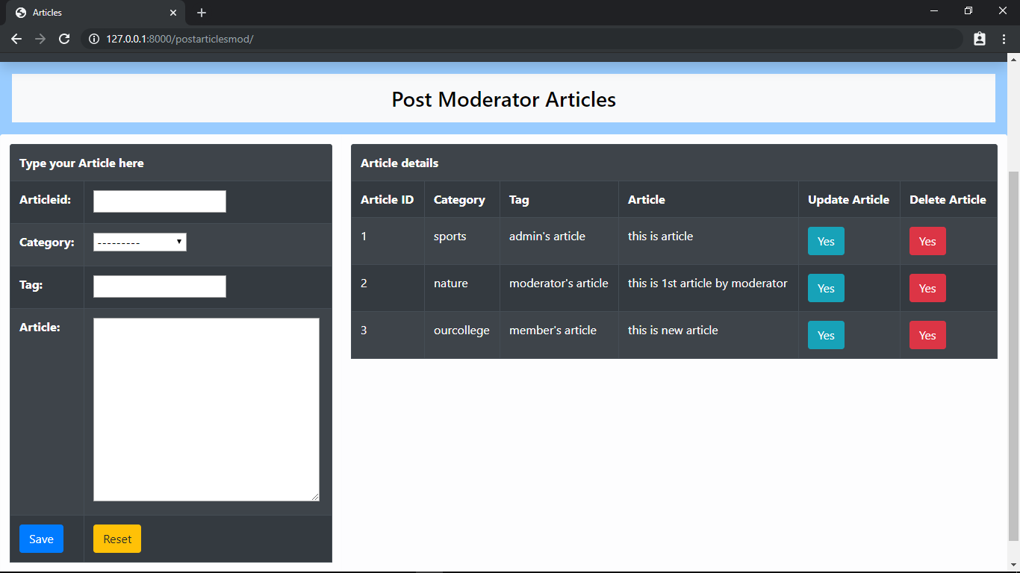
MODERATOR ARTICLE PAGE

Slide 27
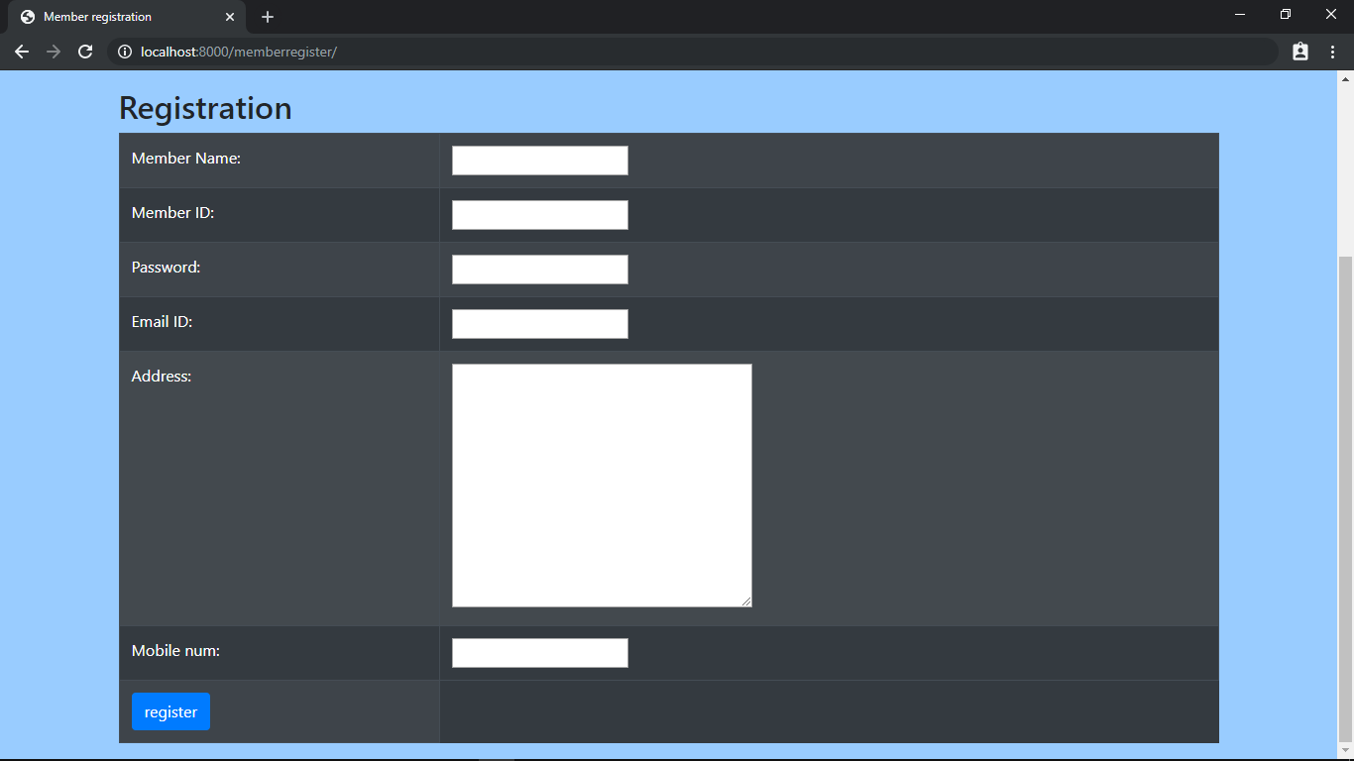
MEMBER REGISTRATION PAGE

Slide 28
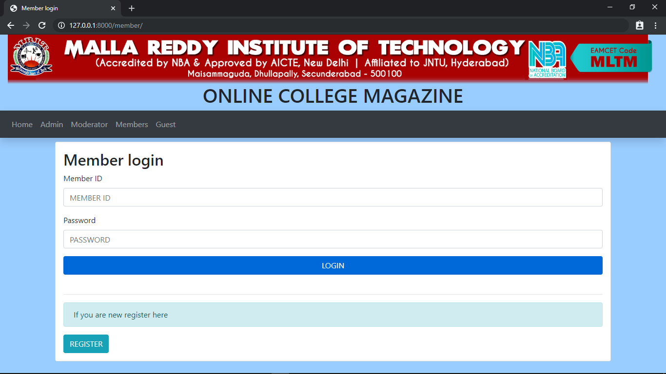
MEMBER LOGIN PAGE

Slide 29
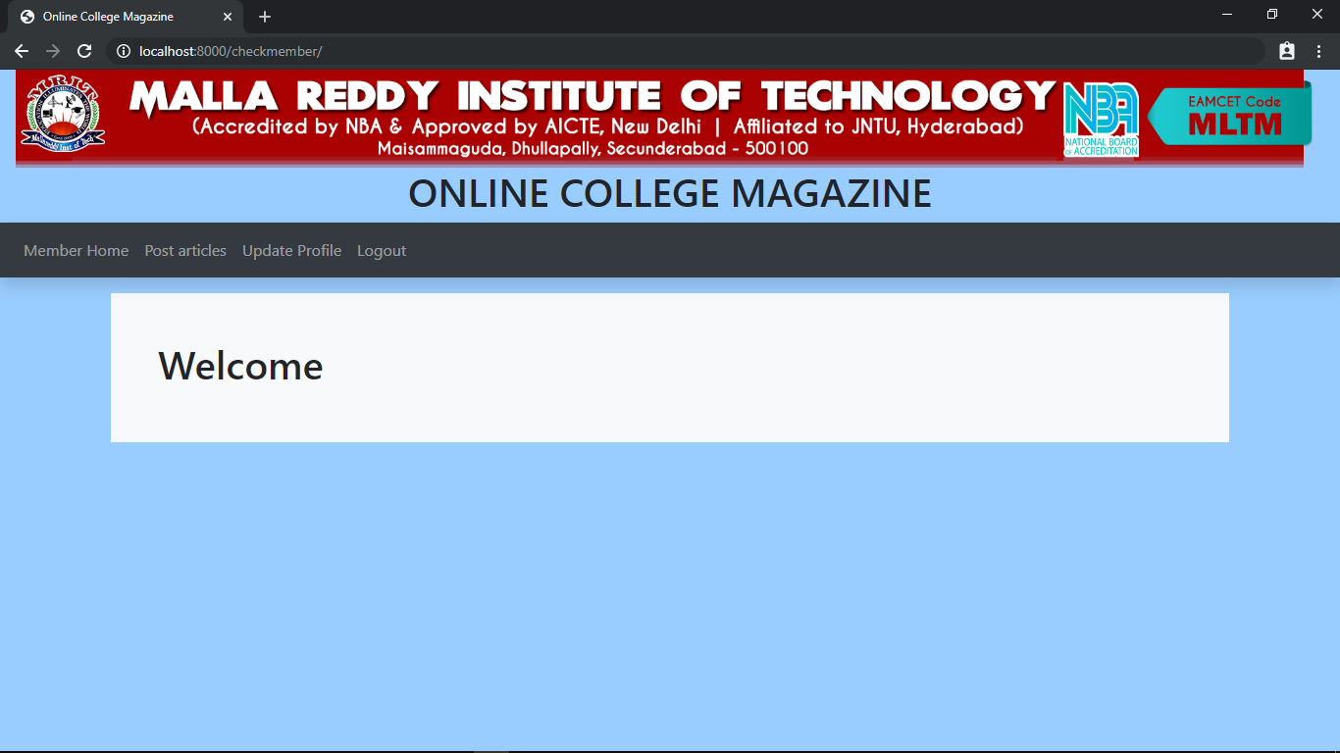
MEMBER HOME PAGE

Slide 30
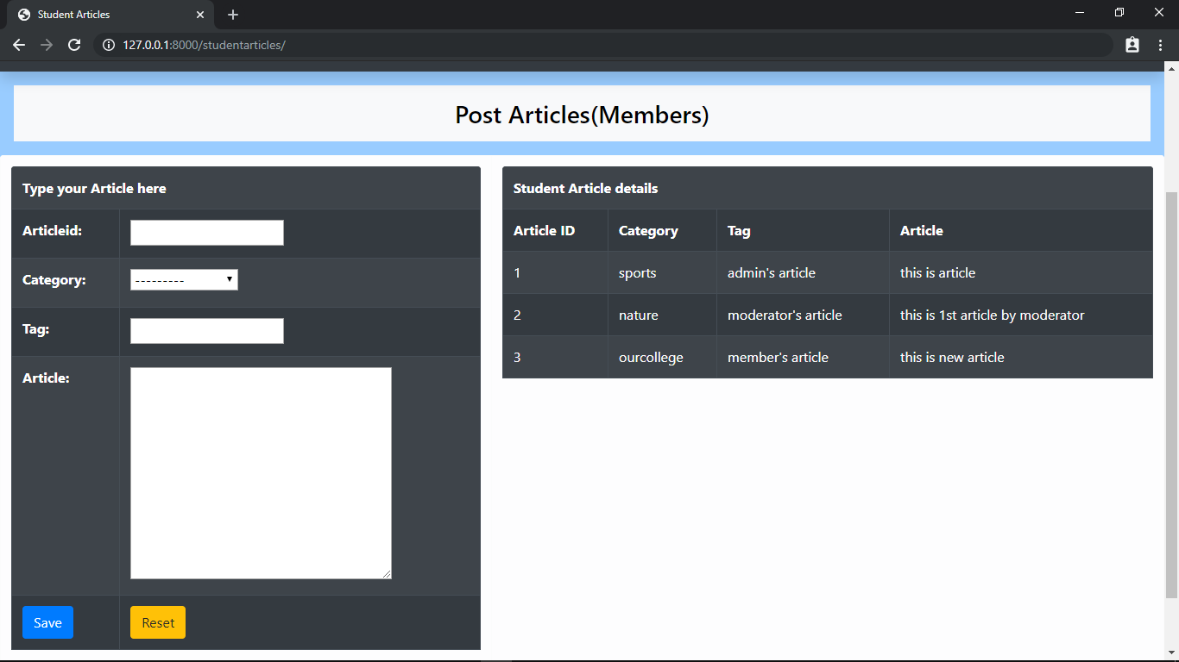
MEMBER ARTICLE PAGE

Slide 31
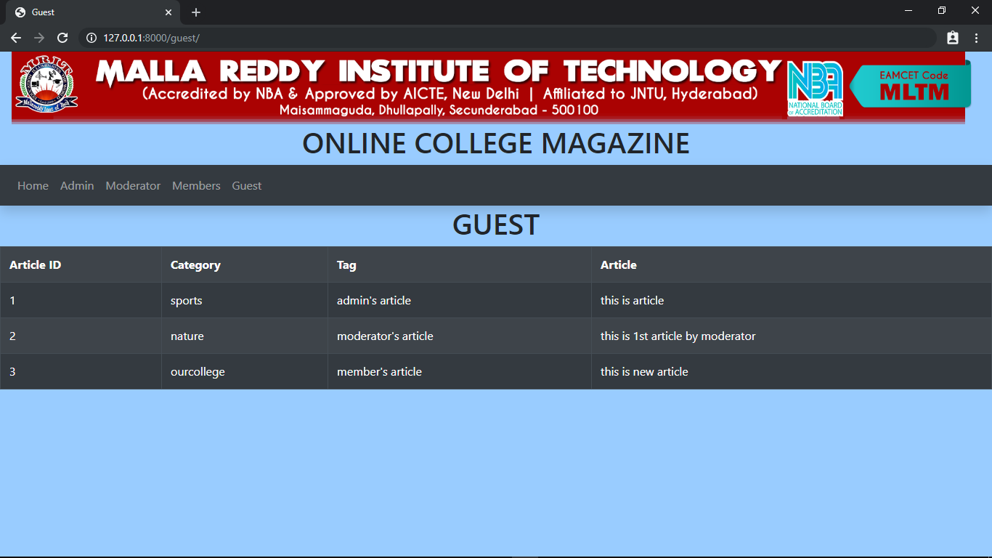
GUESTPAGE

Slide 32
CONCLUSION
College students and faculties can post and read various articles .
So we can post and share articles easily .
This method takes less time and effort.

Slide 33
THANK
YOU

